Slide 1
CS 3353
Greedy Algorithm

Slide 2
Used for optimization problems.
Similar to dynamic programming.
Idea:
  When we have a choice to make, make the one that looks best right now.
  Make a locally optimal choice in hope of getting a globally optimal solution.

Slide 3
Optimality
Greedy algorithms don’t always yield an optimal solution.
Problems in which a greedy approach yields sub-optimal results are not interesting to us.
Problems for which greedy algorithms yield optimal solutions must exhibit optimal substructure.
We’ll look at such problems.

Slide 4
Huffman Codes
Data compression technique
Assigns variable-length binary codes to characters based on frequency
Achieves much superior results to fixed-length codes
Huffman's algorithm determines optimal variable-length code based on a greedy approach

Slide 5
Example
Consider 100,000-character file with 6 letters: a, b, c, d, e and f
 | a | b | c | d | e | f
Frequency | 45k | 13k | 12k | 16k | 9k | 5k
Fixed-Length Code | 000 | 001 | 010 | 011 | 100 | 101 | 300,000 bits
Variable-Length Code | 0 | 101 | 100 | 111 | 1101 | 1100 | 224,000 bits

Slide 6
Prefix Codes
In a prefix code, no code is a prefix of another code.
They simplify decoding
  Codewords are unambiguous
Represented using binary trees, and parsing follows a path from the root to a leaf
  0 means go left
  1 means go right
  Leaves are the coded characters

Slide 7
Example Prefix Codes
100
1
0
a:45
55
0
1
30
25
0
1
0
1
c:12
b:13
14
d:16
0
1
f:5
e:9
Encoding: “abc” → 0.101.100
Decoding: 0.0.111.1100 → “aadf”

Slide 8
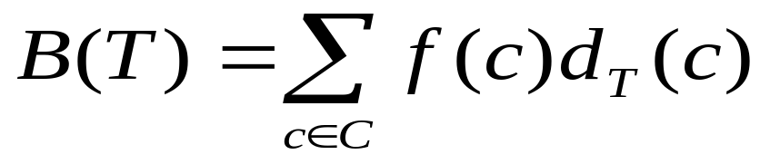
Optimal Prefix Code
An optimal code is always represented by a full binary tree
  Every non-leaf node has two children
Compute the number of bits needed to represent file using tree T
  Let C = set of unique characters in file.
  Let f(c) = frequency of character c in file.
  Let d_{T}(c) = depth of c's leaf node in T

Slide 9
Constructing Prefix Codes
a:45
c:12
b:13
f:5
e:9
d:16
a:45
c:12
b:13
14
d:16
0
1
f:5
e:9

Slide 10
Constructing Prefix Codes
a:45
c:12
b:13
14
d:16
0
1
f:5
e:9
a:45
25
14
d:16
0
1
0
1
c:12
b:13
f:5
e:9

Slide 11
Constructing Prefix Codes
a:45
25
14
d:16
0
1
0
1
c:12
b:13
f:5
e:9
a:45
25
30
0
1
0
1
c:12
b:13
14
d:16
0
1
f:5
e:9

Slide 12
Constructing Prefix Codes
a:45
25
30
a:45
55
0
1
0
1
1
0
c:12
b:13
14
d:16
30
0
1
25
0
1
0
1
f:5
e:9
b:13
14
d:16
c:12
0
1
f:5
e:9

Slide 13
Constructing Prefix Codes
100
1
0
a:45
55
55
a:45
0
1
0
1
30
30
25
0
1
25
0
1
0
1
0
1
c:12
b:13
14
d:16
c:12
b:13
14
d:16
0
1
0
1
f:5
e:9
f:5
e:9

Slide 14
Pseudocode: Huffman
HUFFMAN(C)
n ← |C|
Q ← C
for i ← 1 to n − 1
do allocate a new node z
left[z] ← x ← EXTRACT-MIN(Q)
right[z] ← y ← EXTRACT-MIN(Q)
f[z] ← f[x] + f[y]
INSERT(Q, z)
return EXTRACT-MIN(Q)

Slide 15
Greedy Properties
To show that Huffman is optimal:
  Show that it exhibits the greedy-choice property
    That is, we can pick the two lowest frequencies
  Show that it exhibits optimal substructure property
    That is, picking the lowest two frequencies produces an optimal tree

